Slide 1
SOFTWARE PROJECT MANAGEMENT

Slide 2
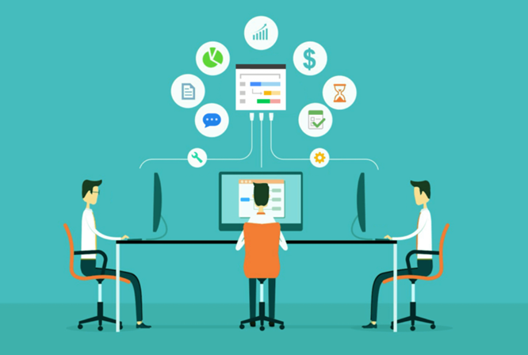
Software Project Management Fundamentals

Slide 3
Software Project Management Fundamentals
Software Engineering is very relevant for large projects
These large projects could involve several people (10s to 100s to 1000s) working together for a prolonged length of time (several months to years)
These projects need to be planned (which is significant % of the management activity) and controlled
This needs co-ordination for ensuring Integration/ interoperability/ & working together

Slide 4
Software Projects and their characteristics
Software projects are temporary individual or collaborative enterprises that are carefully planned to achieve a particular aim/or to create a unique product or service. These projects typically have certain characteristics
They are made up of certain unique activities which do not repeat under similar circumstances
They are goal specific
Typically contain a sequence of activities to deliver the end product
Time bound- Every project has a specified start and end date
Technically inter-related activities

Slide 5
Software Project Management Fundamentals
Projects are constrained by Scope, Time (Schedule), Cost (of all Resources)
Project Management will need to maintain this triangle in Equilibrium
Cost
Scope
Quality of Project
Time

Slide 6
Software Project Management Lifecycle
Project Management Life Cycle
Initiation and Approval
Monitoring Execution and Control
Planning
Closing
Step 2
Step 4
Step 1
Step 2
Step 3
System/Software Development Life Cycle
Implementation
Testing
Requirements Eng.
Design
Architecture
Deploy

Slide 7

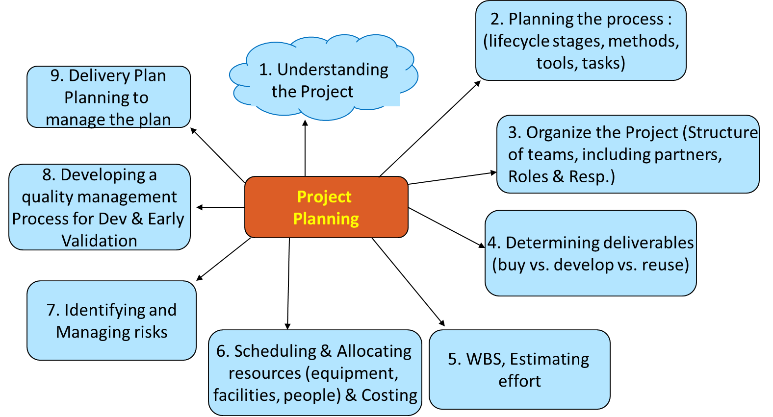
Project planning process
More details towards planning will be discussed in the next session

Slide 8
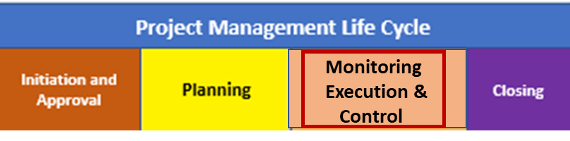
Software Project Monitoring and Control
Project Monitoring and control of the project begins once the project plan is created.
The Monitoring and Controlling process is continuously performed and encompasses all the tasks and uses all the measures and metrics necessary to ensure that the project is on track e.g. within scope, on-time, within budget and proceeds with minimal risk.
Project monitoring involves using Quantitative data which is continuously collected all along the project
Project control activities involves making decisions or adjustments in dimensions like time, cost, organizational structure, Scope etc. for the project under execution

Slide 9
Software Project Monitoring and Control
Project monitoring and control dimensions could be :
Time, both the in terms of effort (number of man-months) and the schedule
Measuring progress is hard (“we spent half the money, so we must be halfway”)
Development models serve to manage time
More people ⇒ less time?
Brooks’ law: adding people to a late project makes it later

Slide 10
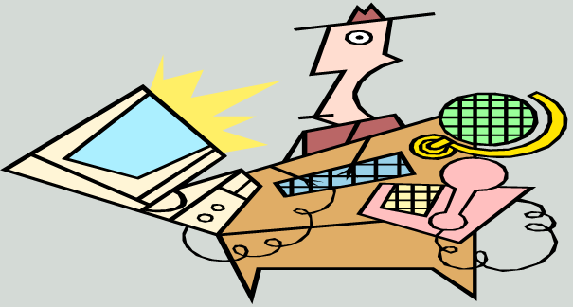
Software Project Monitoring and Control
Project monitoring and control dimensions (Cont.)
Information (availability, propagation) - communication including documentation
Documentation
Technical documentation
Current state of projects
Changes agreed upon
…
Agile projects: less attention to explicit documentation, more on tacit knowledge held by people

Slide 11
Software Project Monitoring and Control
Project monitoring and control dimensions (Cont.)
Organization and its structure, roles & responsibilities (people and team aspects)
Building a team
Reorganizing structures
Clarifying, managing expectations and reorienting roles and responsibilities
Coordination of work

Slide 12
Software Project Monitoring and Control
Project monitoring and control dimensions (Cont.)
Quality is not an add-on feature; it has to be built in.
(what are leading indicators and what are lagging indicators)
Quality has to be designed in
Quality is not an afterthought
Quality requirements often conflict with each other
Requires frequent interaction with stakeholders

Slide 13
Software Project Monitoring and Control
Project monitoring and control dimensions (Cont.)
Cost, Infrastructure & Personnel (Capital and Expense)
Project retrospective also needs to happen, using the data collected more like postmortem of this project to operate better in the next project execution
Capability maturity models which will be discussed later helps in this perspective
Which factors influence cost?
What influences productivity?
Relation between cost and schedule

Slide 14
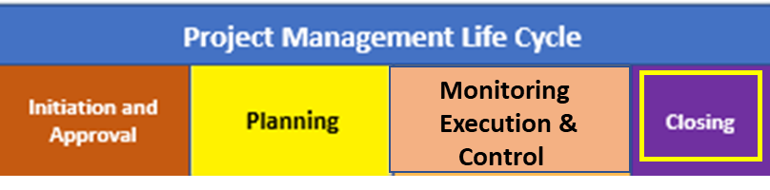
Project Closure
The Project Closure Phase will formally close the project and then report its overall level of success to the sponsor.
Steps Involved
Hand over deliverables to customer & obtain project or UAT (User Acceptance Testing) sign-off from client to confirm that the team has met the project objectives & the agreed requirements
Complete documentation and pass it on to Business and cancel supplier contracts
Release staff and equipment, and inform stakeholders of closure.
Post Mortem - Post Implementation Review is completed to determine the projects success and identify the lessons learned.
Of-course Celebrate Success

